Slide 1
TEAM – VALIANT 6
TEAM MEMBERS :
1.TRIPTI SINGH
2.SHREYASH KUMAR
3.SAFIA AKTAR
4.NAMRATA KUMARI
5.SHIBASHIS PRIYABRAT
6.TITHI SINGH
MENTOR : PRASANT KUMAR DASH

Slide 2
PROBLEM STATEMENT :
DEVELOPMENT OF VR/AR (VIRTUAL REALITY/ AUGMENTED REALITY) BASED APPLICATION TO TRAIN AND UPSKILL THE WORKFORCE INVOLVED IN SAFELY EXECUTING HIGH RISK TASKS AND PROBLEM-SOLVING KEY OPERATIONAL CHALLENGES IN COAL MINING INDUSTRY

Slide 3
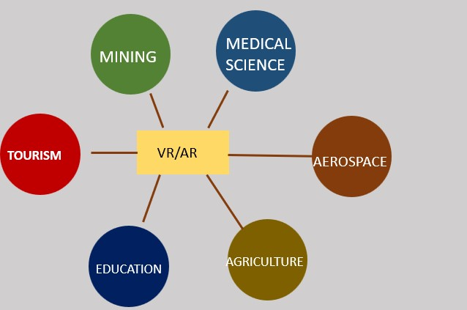
WHAT IS AR AND VR?
Augmented reality (AR) and Virtual Reality (VR) bridge the digital and physical worlds. They allow you to take in information and content visually, in the same way you take in the world.

Slide 4
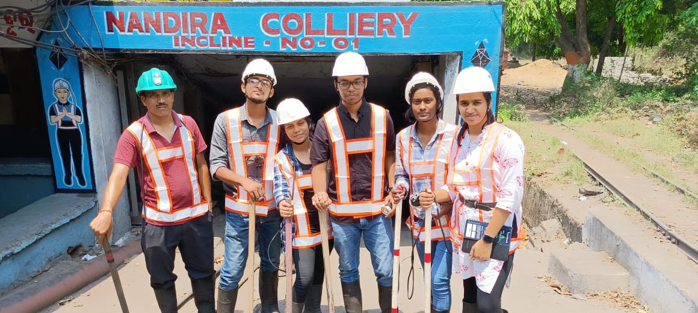
OUR COAL MINE VISIT

Slide 5
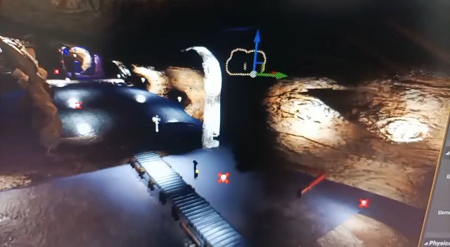
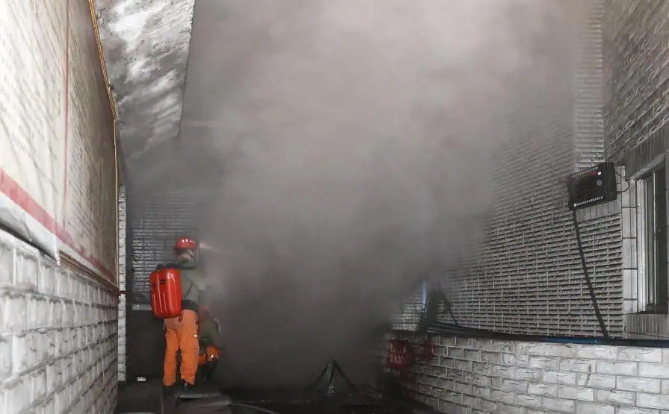
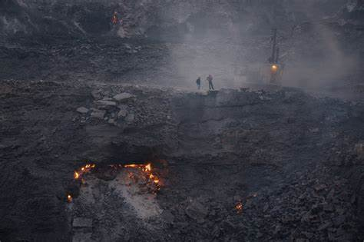
RISK FACTORS:
WATER INUNDATION:
2.GAS LEAKAGE:
3.FIRE OUTBREAK:

Slide 6






WHAT ARE THE HAZARDS?

Slide 8
OUR SOLUTION
Solution statement-To make a Virtual Reality Experience for training workers.
Benefits from our solution
It will prepare them for any kind of life risking situations
Enhance their skills
Prepare them beforehand of the conditions they will face while working in the coal mines.
This is also going to help the government choose capable staffs
Maximizing the output from the coal mines that in turn is going to increase the revenue for the government

Slide 9
Comparison
Traditional training
Virtual reality training
Potential Injury
Likely Hood of fatal accidents
Incapable Trainers
Equipment Cost
Harsh training conditions
No injury
No Fatality
Fool proof Training
Significant reduction in equipment cost
User friendly training conditions

Slide 10
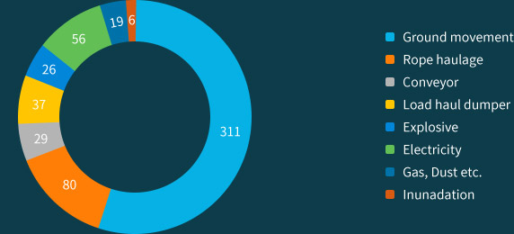

STATISTICAL DATA OF HAZARDS IN COAL MINES

